Slide 1
College Selection Model
By TAZY GROUP - Tyler, Anwar, Zac, Yvonne
Notes:
Yvonne

Slide 2
Agenda
❖Team Introduction
❖Project Overview
❖Dataset Overview
❖Data Analysis and Preparation
❖General Information
❖Develop College Selection Model
❖Statistical Analysis
❖Evaluation & Findings
❖Model Demonstration
❖Conclusion
Notes:
Yvonne

Slide 3
Project Overview
Request from Prince George’s County Board of Education to provide a data-driven presentation about choosing potential universities or colleges to attend
●Intended Audience: junior year high school students and their parents
●Research Question: Which universities or colleges should “typical” junior year high school students from Prince George’s County public schools consider attending, and what institutional characteristics should they take into consideration when choosing?
●Data Source Used to Answer the Research Question
○US Department of Education’s College Scorecard Dataset
(https://collegescorecard.ed.gov/)
Notes:
Zac

Slide 4
College Scorecard Data Set Overview
●What data is available to us in the College Scorecard dataset?
A listing of all colleges and universities in the US, with over 1,700 data points.
For each school, there is describe basic information about the institution (name, location, highest-degree awarded, accrediting agency), as well as other data points regarding admissions, academics, costs, student body, financial aid, completion, earnings, and repayment.
●Where does the College Scorecard data come from?
These data are provided through federal reporting from the institutions, data on federal financial aid, and tax information. The College Scorecard project is designed to increase transparency, putting the power in the hands of students and families to compare how well individual postsecondary institutions are preparing their students to be successful.
Notes:
Zac

Slide 5
Data Analysis and Preparation
In order to best answer our research question, we wanted to reduce the data set down to only appropriate schools and only use the most relevant data points
●Created data set with relevant pool of schools for analysis that are:
Within the 50 states or DC, no US territories included (ex: Puerto Rico)
Degree-granting institutions only
Currently operating
Not under heightened cash monitoring
Are not exclusively for graduate students
Data Reduction
Reduced from 1,779 variables to 173 variables
Reduced from 7,593 schools to 3,824 schools
Notes:
Zac

Slide 6
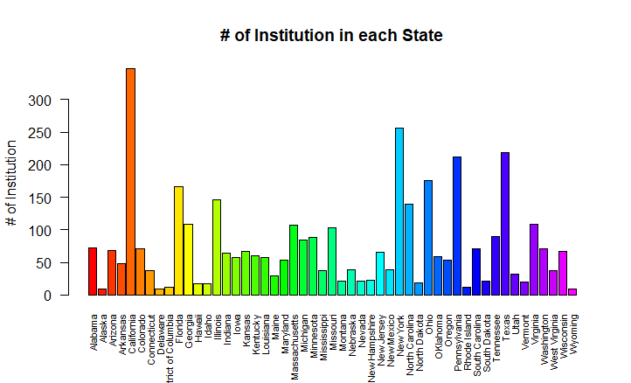
General Information - # of Colleges by Region
There are 3824 colleges, with California having the most at 347; New York the next highest at 256, and Delaware and Alaska having the least, 9 colleges
Notes:
Yvonne

Slide 7
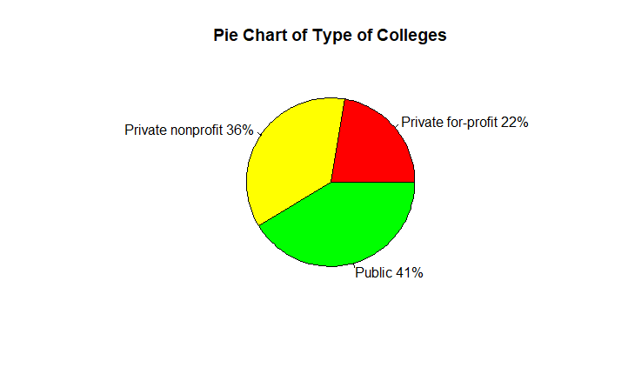
General Information - Type of Colleges
There are 1581 Public, 1388 Private nonprofit, and 855 Private for-profit colleges
Notes:
Yvonne

Slide 8
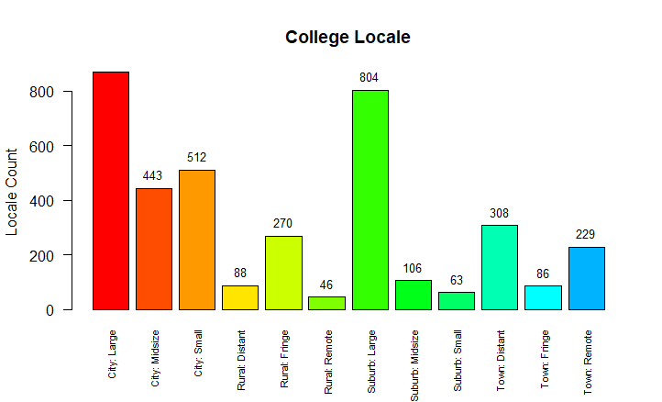
General Information - College Locale
Most colleges are located in large cities.
Notes:
Yvonne

Slide 9
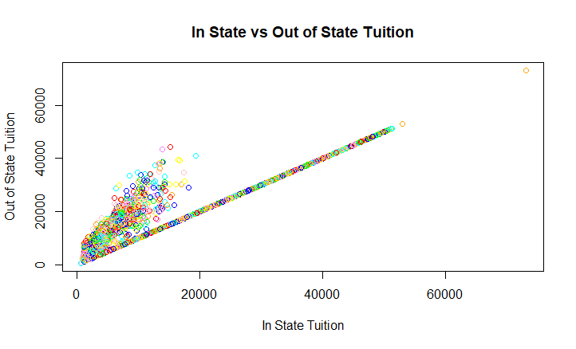
General Information - Tuition and Fees
The range of in-state and out-of-state tuition falls between $590 and $73,132. There is a positive correlation between in-state tuition and out-of state tuition. As in-state tuition increases, out-of-state tuition increases
Notes:
Yvonne

Slide 10
Develop College Selection Model
There are three steps to our College Selection Model:
For each school in the data set, we rated the student financial stability and academic success (rating method explained next slide) of that school
We developed four unique personas
Selected the most appropriate list of schools for each persona
Notes:
Zac

Slide 11
Statistical Analysis - Financial Stability
The variables chosen as the best indicators of student financial stability are:
Percent of students who defaulted or failed to meet specified conditions within two (2) year and three(3) years of receiving their loan
Average earnings of students 10 years after graduating
Median debt of students who completed their degree
In state tuition and out of state tuition costs and fees
To confirm that we had chosen the best indicators, we use the plot function to verify the relationship between the variables
Notes:
Zac

Slide 12
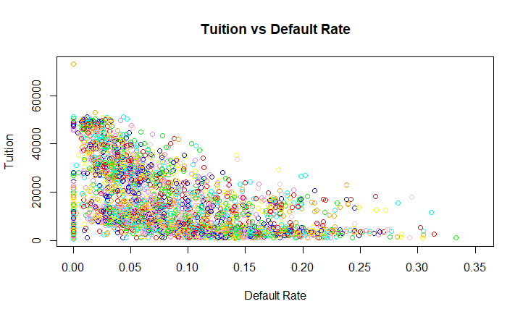
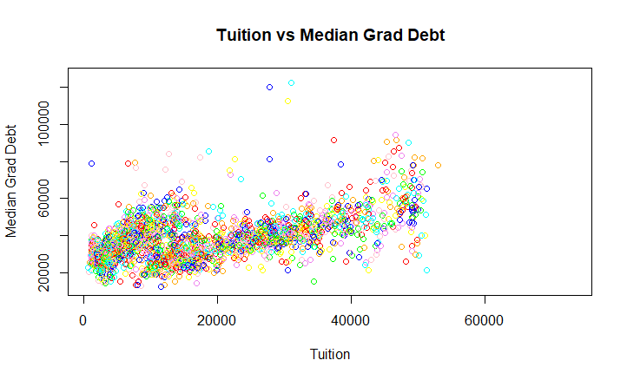
Statistical Analysis - Financial Stability (cont)
As default rate increases, tuition decreases
As tuition increases, median grad debt increases
Notes:
Zac

Slide 13
Statistical Analysis - Academic Success
The variables chosen as the best indicators of academic success are:
First-time full-time student retention rate
First-time full-time completion rate
Percentage of students that withdrew from original institution within 3 years
Proportion of full-time faculty staff
To confirm that we had chosen the best indicators, we use the plot function to verify the relationship between the variables
Notes:
Ty

Slide 14
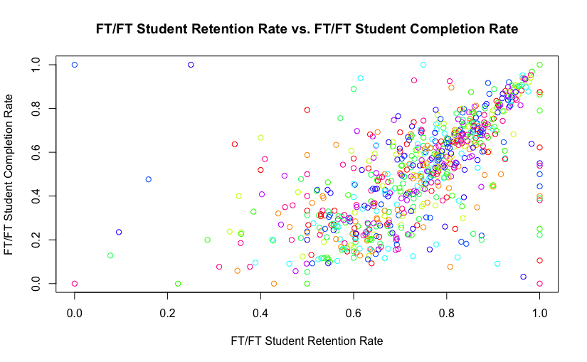
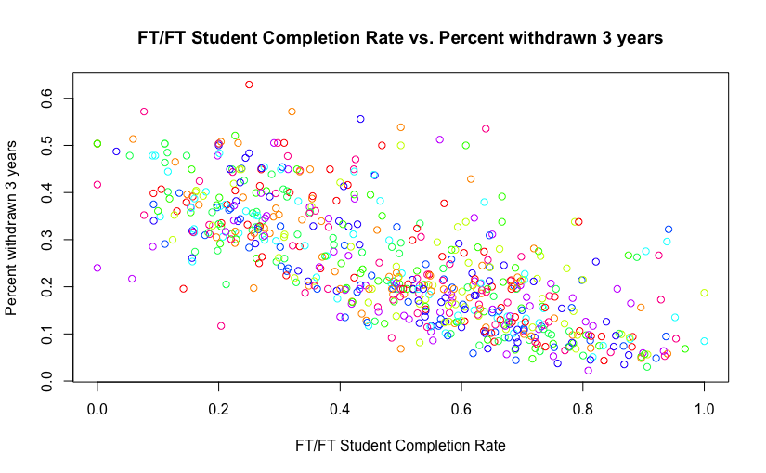
Statistical Analysis - Academic Success (cont)
As retention rate increases, completion rate increases
As completion rate increases, percent withdrawn decreases
Notes:
Ty

Slide 15
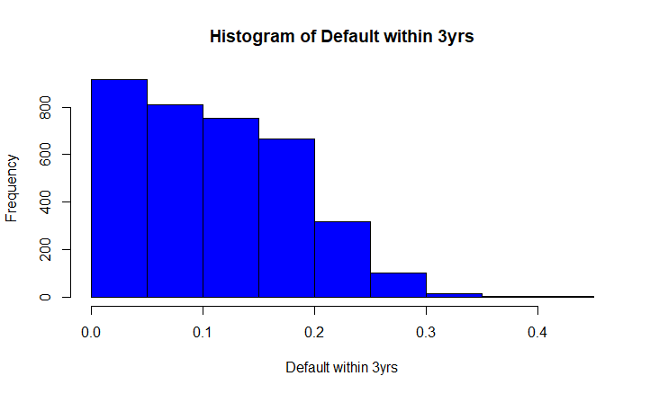
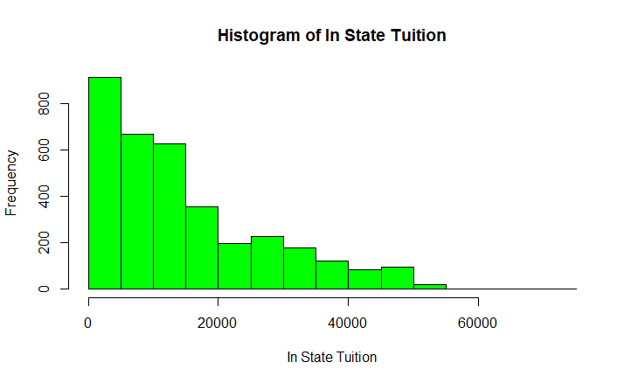
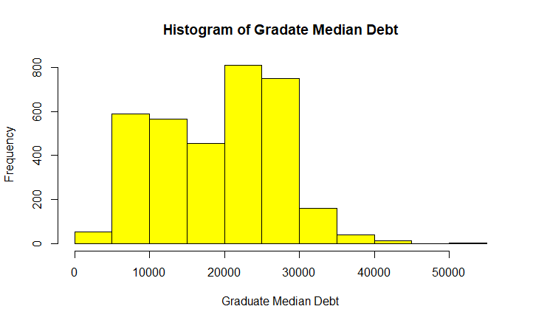
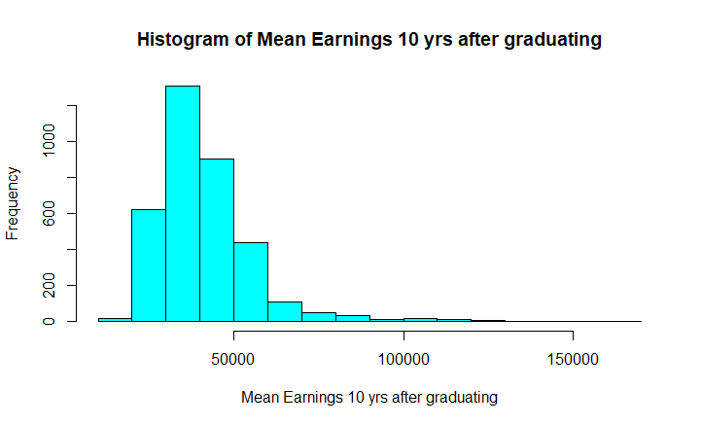
Statistical Analysis - Financial Stability Superscore
For each of the variables, calculate the mean, standard deviation, z-scores. Then sum the z-scores to get the Super Score
Notes:
Anwar

Slide 16
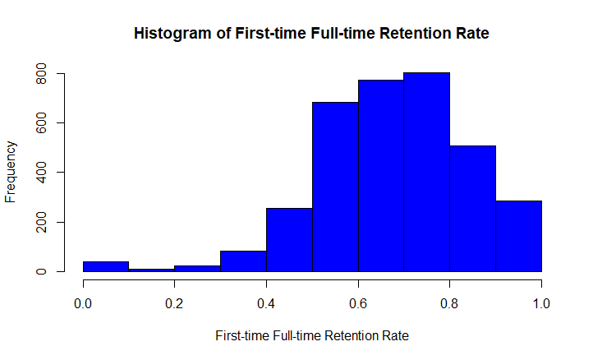
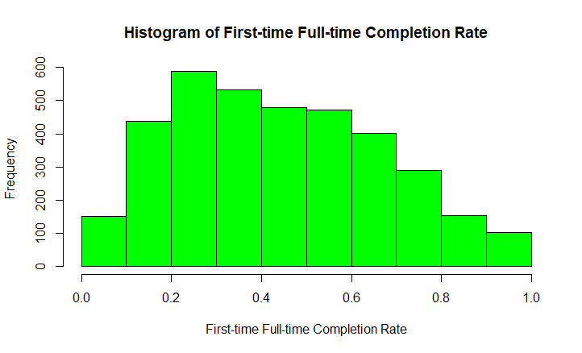
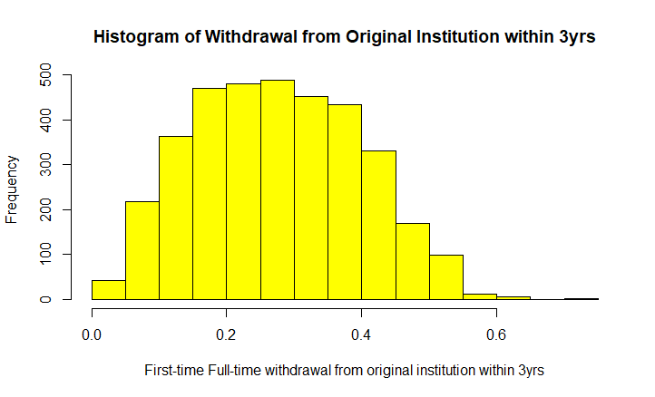
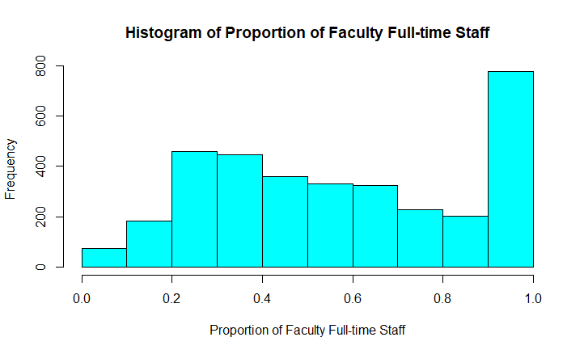
Statistical Analysis - Academic Success Superscore
For each of the variables, calculate the mean, standard deviation, z-scores. Then sum the z-scores to get the Superscore
Notes:
Anwar

Slide 17
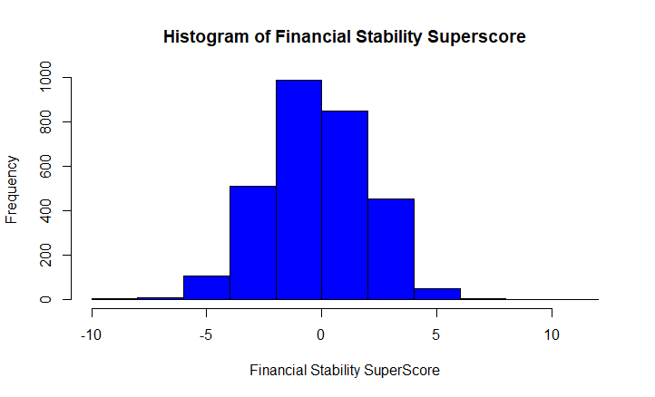
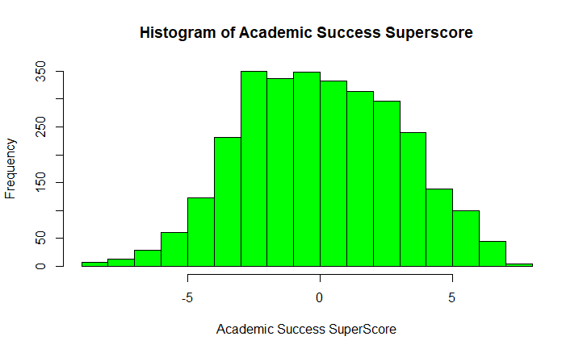
Evaluation & Findings - Superscores
Financial Stability ranking ranged from -8.5 to 10.5
Academic Success range -9 to 7.2
Notes:
Anwar

Slide 18
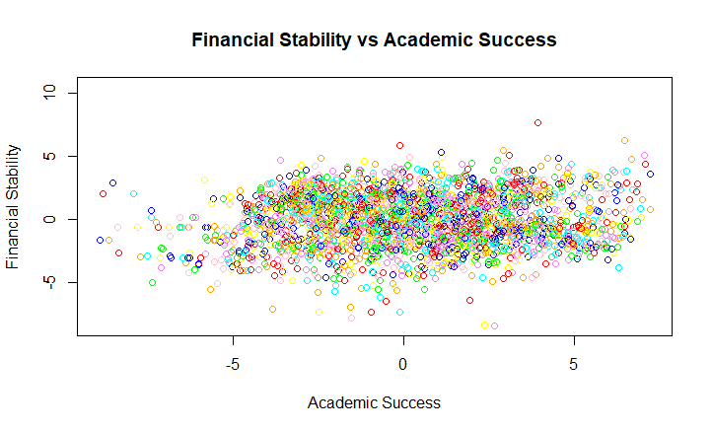
Evaluation & Findings - Financial Stability vs Academic Success
There is no relationship between academic success and financial stability. In other words, academic success does not guarantee financial success
Notes:
Anwar

Slide 19
Model Demonstration for John Brown
New York School, 30 ACT >= School’s ACT 25th Percentile, Public School, Out-of-state Tuition <= $26,000, then sort by Academic Student Success Super Score
Institution | City | ACT 25th Percentile | In State Tuition | Out-of-State Tuition | Locale | State | Control | College Size | FS SuperScore | AS SuperScore
SUNY at Binghamton | Vestal | 27 | $9,053 | $22,173 | Suburb: Midsize | New York | Public | Four-year, large, highly residential | 4.05 | 4.82
SUNY College of Environmental Science and Forestry | Syracuse | 25 | $7,848 | $17,698 | City: Midsize | New York | Public | Four-year, small, primarily residential | 3.08 | 4.09
SUNY Oneonta | Oneonta | 22 | $7,870 | $17,720 | Town: Remote | New York | Public | Four-year, medium, highly residential | 2.36 | 3.87
University at Buffalo | Buffalo | 24 | $9,381 | $24,461 | Suburb: Large | New York | Public | Four-year, large, primarily residential | 3.03 | 3.86
Stony Brook University | Stony Brook | 26 | $8,855 | $23,935 | Suburb: Large | New York | Public | Four-year, large, highly residential | 3.20 | 3.73
Notes:
Ty

Slide 20
Model Demonstration for Mary Jane
Wants to Attend College Locally DMV Area, Prefers to Attend Public University/College, Does not want to attend school in Rural Area, average retention rate is 70%+ for full time first time students
Institution | City | In-State Tuition | Out-State Tuition | Local | State | Control | College Size | Retention Rate | FS SuperScore | AS SuperScore
University of Virginia-Main Campus | Charlottesville | $15,192 | $44,365 | Suburb: Small | Virginia | Public | Four-year, large, primarily residential | 96.9% | 2.84 | 6.84
College of William and Mary | Williamsburg | $19,372 | $41,072 | Suburb: Small | Virginia | Public | Four-year, medium, highly residential | 95.5% | 2.31 | 6.36
Virginia Polytechnic Institute and State University | Blacksburg | $12,485 | $29,129 | City: Small | Virginia | Public | Four-year, large, primarily residential | 93.8% | 2.72 | 6.28
University of Maryland-College Park | College Park | $9,996 | $31,144 | Suburb: Large | Maryland | Public | Four-year, large, primarily residential | 95.4% | 3.54 | 5.60
Virginia Military Institute | Lexington | $16,536 | $39,550 | Town: Distant | Virginia | Public | Four-year, small, highly residential | 92.0% | 0.69 | 5.43
Notes:
Ty

Slide 21
Model Demonstration for Mark Lucas Brown
State = MD, VA, DC, DE, PA; mean earnings 10 years after graduation are at least $60,000+; prefers 4-year school
Institution | City | In-State Tuition | Out-of State | Mean Earnings | Local | State | Control | College Size | FS SuperScore | AS SuperScore
University of Virginia-Main Campus | Charlottesville | $15,192 | $44,365 | $77,200 | Suburb: Small | Virginia | Public | Four-year, large, primarily residential | 2.84 | 6.83
Bucknell University | Lewisburg | $50,152 | $50,152 | $76,300 | Town: Distant | Pennsylvania | Private nonprofit | Four-year, medium, highly residential | -1.55 | 6.64
Johns Hopkins University | Baltimore | $48,710 | $48,710 | $85,800 | City: Large | Maryland | Private nonprofit | Four-year, large, highly residential | 0.86 | 6.63
Carnegie Mellon University | Pittsburgh | $50,665 | $50,665 | $102,700 | City: Large | Pennsylvania | Private nonprofit | Four-year, large, highly residential | 0.54 | 6.44
College of William and Mary | Williamsburg | $19,372 | $41,072 | $68,700 | Suburb: Small | Virginia | Public | Four-year, medium, highly residential | 2.32 | 6.35
Notes:
Ty

Slide 22
Model Demonstration for James Doe
4-year school, public school, located in New Jersey or Pennsylvania, small city type locale
Institution | City | In-State Tuition | Out-of State | Local | State | Degree Awarding | Control | College Size | FS SuperScore | AS SuperScore
Pennsylvania State University-Main Campus | University Park | $17,514 | $31,346 | City: Small | Pennsylvania | bachelor's degree granting | Public | Four-year, large, primarily residential | 0.00 | 4.60
Rutgers University-New Brunswick | New Brunswick | $14,131 | $29,521 | City: Small | New Jersey | bachelor's degree granting | Public | Four-year, large, primarily residential | 2.25 | 4.21
Bloomsburg University of Pennsylvania | Bloomsburg | $9,326 | $20,144 | City: Small | Pennsylvania | bachelor's degree granting | Public | Four-year, medium, primarily residential | 1.33 | 3.27
Pennsylvania State University-Penn State Altoona | Altoona | $14,610 | $22,344 | City: Small | Pennsylvania | bachelor's degree granting | Public | Four-year, medium, primarily residential | 1.04 | 2.99
Rutgers University-Camden | Camden | $14,000 | $28,890 | City: Small | New Jersey | bachelor's degree granting | Public | Four-year, medium, primarily nonresidential | 2.32 | 2.36
Notes:
Ty

Slide 23
Conclusion
Other students may have a different collection of potential schools, after taking into account their unique school selection criteria. They can also view which schools rate highest according to both the Student Financial Stability and Student Academic Success Super Scores, using the modified College Selection Model Dataset linked below: https://github.com/brooksrelyt/infm600/blob/master/College%20Scorecard%20Analysis%20Project/Data/College_Selection_Model_Dataset.xlsx
Notes:
Zac

Slide 24
Q&A
Open for Questions

